Slide 1
UML-Based Service Robot Software Development
Alex Summer
March 24, 2008

Slide 2
Authors
Minseong Kim, Suntae Kim,
Sooyong Park
Department of Computer Science
Sogang University
Seoul, REP. of KOREA
Hassan Gomaa
Dept. of Information and Software
Engineering
George Mason University
Fairfax, VA 22030, USA
Mun-Taek Choi, Munsang Kim
Center for Intelligent Robotics
Frontier 21 Program at Korea Institute
of Science and Technology
Seoul, REP. of KOREA

Slide 3
Topics
What is a service robot?
Architecture of a service robot
Design methods used during development
Lessons learned -> Conclusion

Slide 4
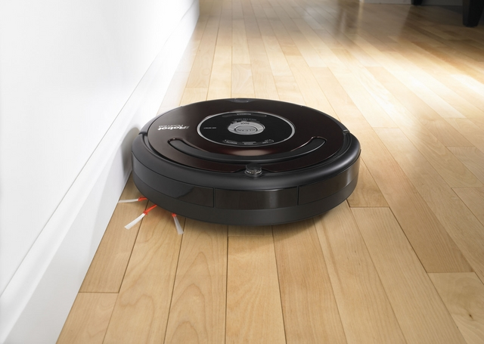
Public Service Robots (PSR)
Perform tasks in a specific environment for working with or assisting humans and must be able to perform services semi or fully automatic

Slide 5
Architecture
Must be well-defined
Many-to-many relations among software components as well as hardware components
Functional performance of software/hardware modules is highly dependent on the architecture
Must support reusable modules

Slide 6

T-Rot
Assisting the elderly
Over 150 engineers from different organizations participate in the implementation
Development teams communicate using UML notation
Applied the COMET method

Slide 7
COMET Method
Real-time and distributed applications
Integrates object-oriented and concurrent processing concepts
Uses UML notation
3 phases: Requirements modeling, Analysis modeling, Design modeling

Slide 8
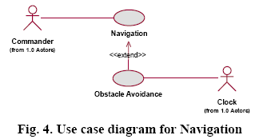
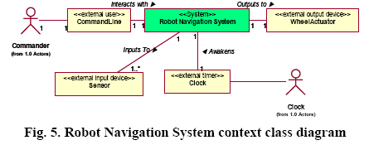
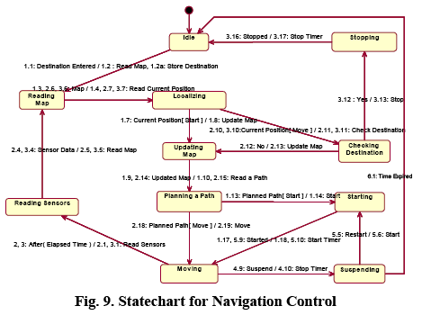
Requirements Modeling
Analysis Modeling
Design Modeling

Slide 9
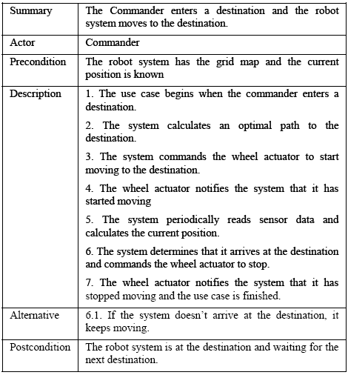
Navigation Use Case Description

Slide 10
Conclusion
So far, so good.
UML aids communication
COMET integrates well with UML and guides the incremental process of development
Potential design issues with task manager

